Slide 1
IDForWeb User Testing Instructions (Web)
Georgia Tech Institute of Information Security and Privacy
GT-IISP

Slide 2
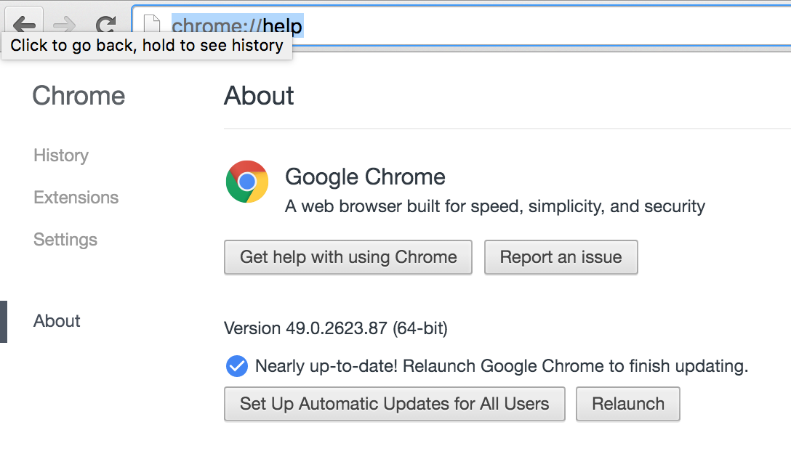
Web-app Prerequisites
Use the latest version of Google Chrome
Download from the following link
https://www.google.com/chrome/browser/desktop/index.html
Check the version is over 49
Type chrome://help at the address bar

Slide 3
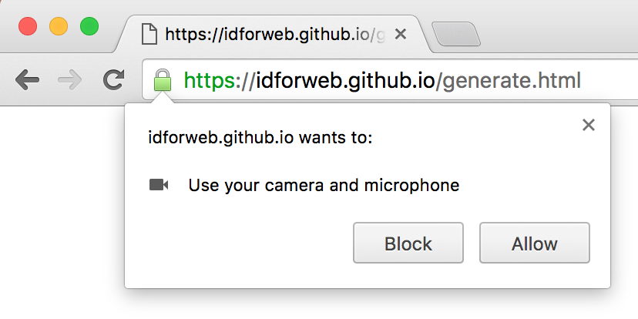
Web-app Prerequisites
Have web-cam and microphone equipped with the computer
Most of laptops will have such setup.
Make sure you allow access to MIC and CAM to the browser, by clicking ‘Allow’ if following pop-up is displayed.

Slide 4
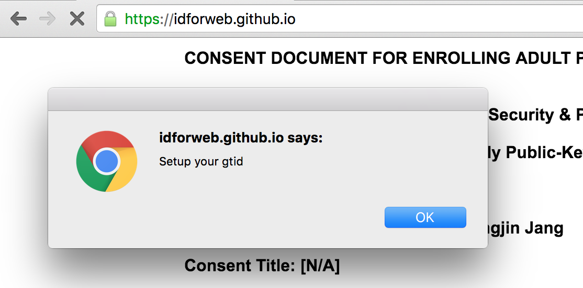
Testing Setup (One-time)
Connect to the following URL
https://idforweb.github.io
At the first time, you are asked to setup the app with your GTID

Slide 5
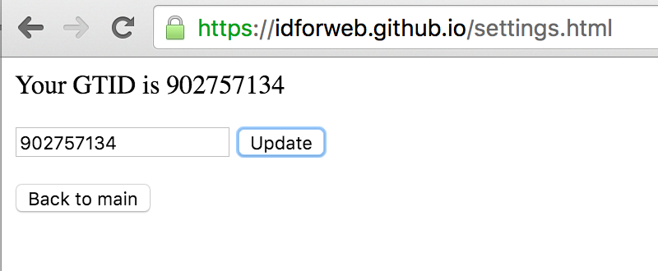
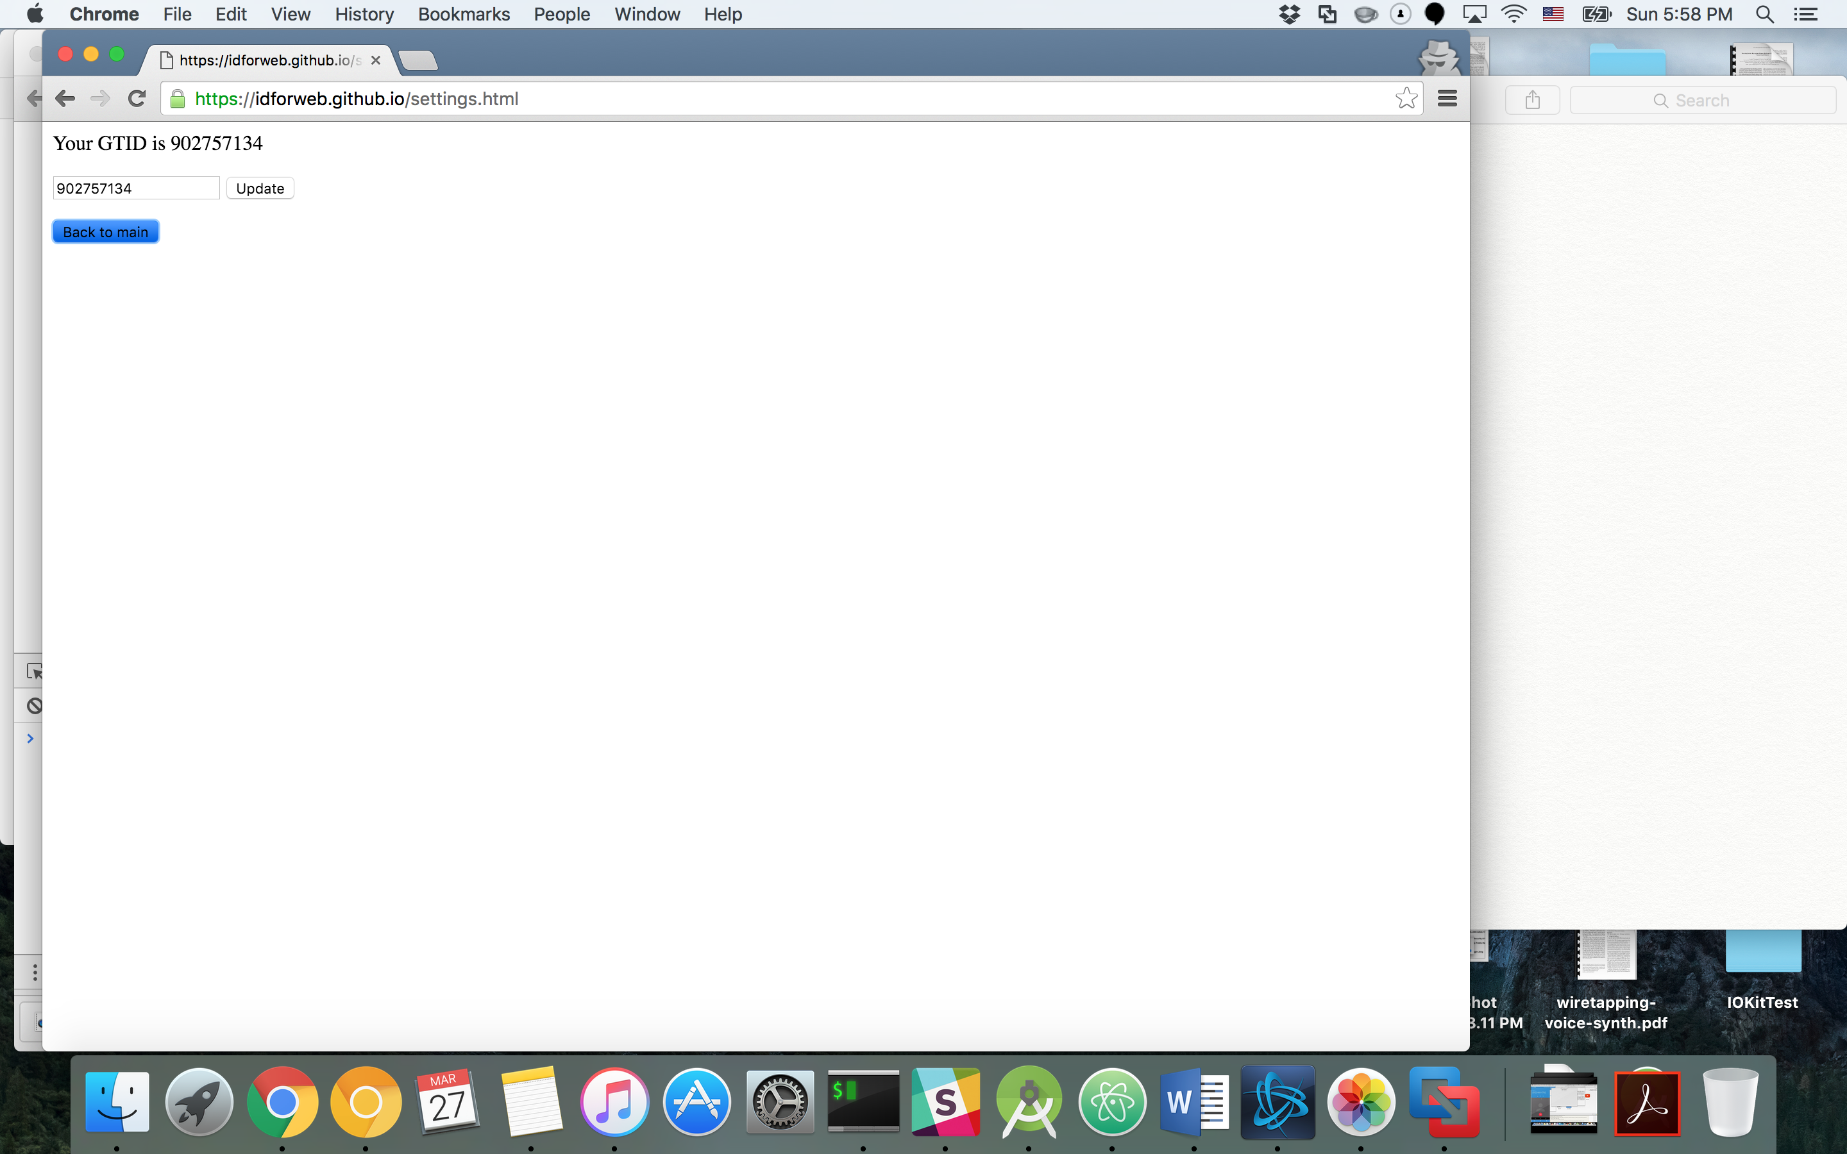
Testing Setup (One-time)
Type GTID, and click UPDATE to store your GTID
Make sure your GTID is shown at the top.
It must be a 9 digit (only digits are allow) number
Click Back to main to continue

Slide 6
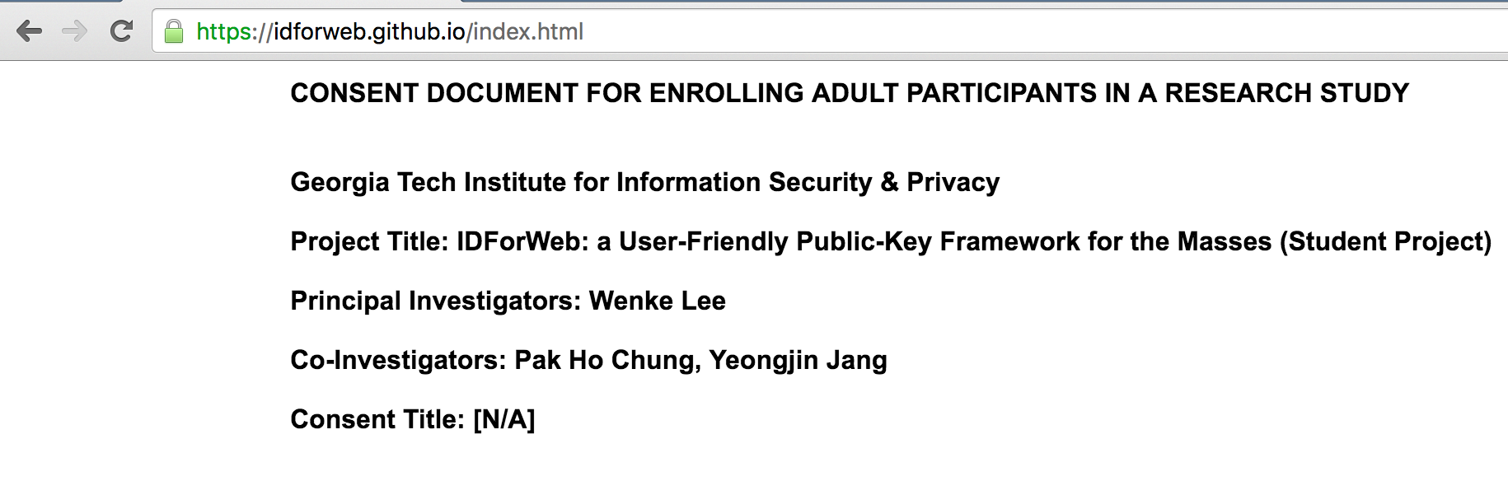
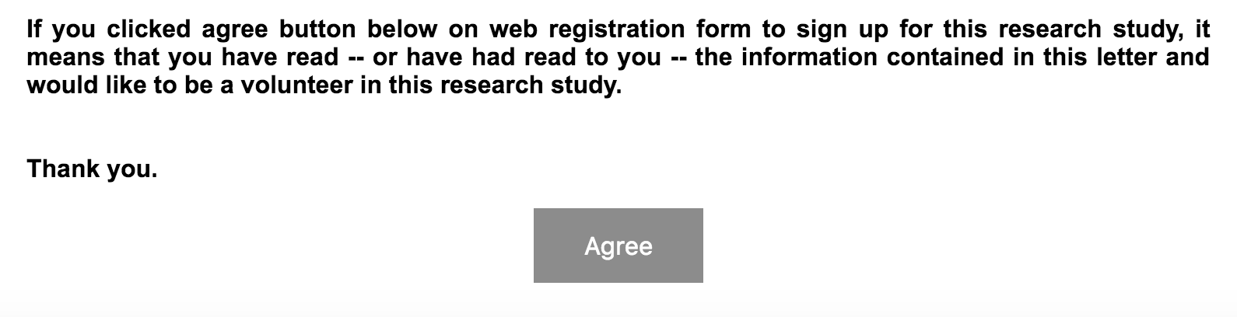
Consent Form
As a first step, we get approval of consent from from the participants.
Let them read through the article, and click ‘Agree’ if they agree to the contents.
You should only proceed the user testing only if the participants voluntarily agreed to this consent form.

Slide 7
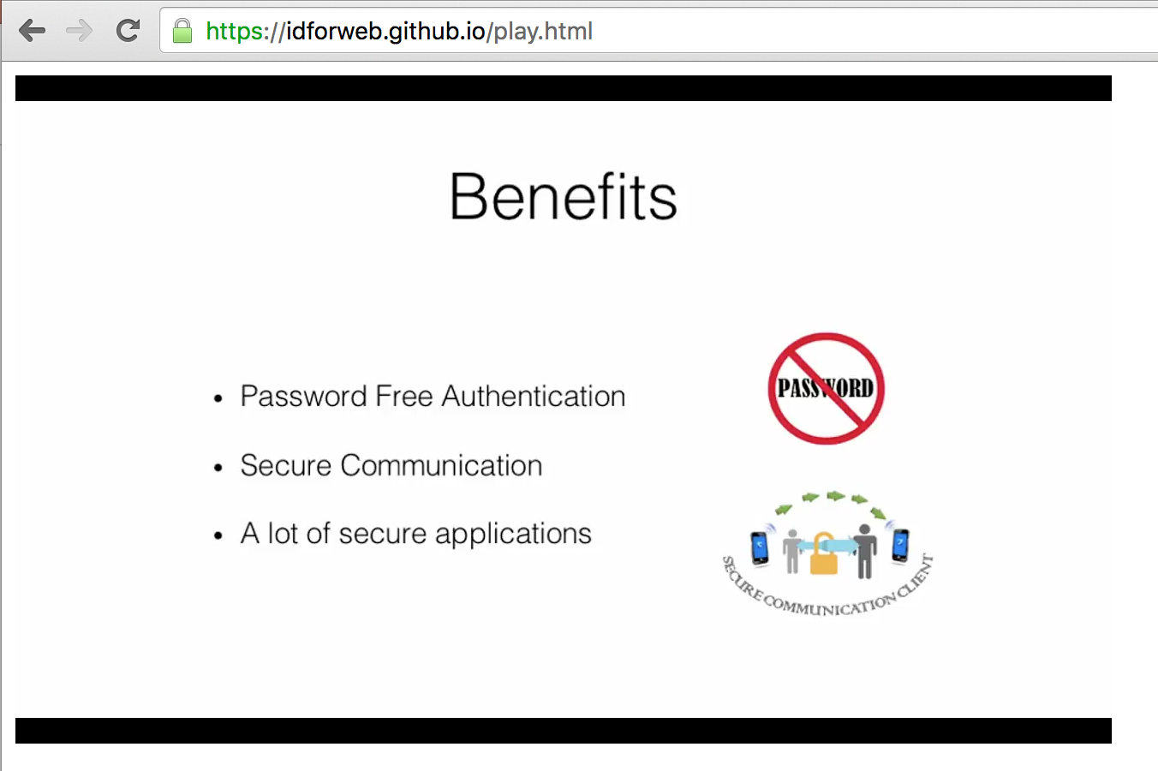
Introductory Video
A 6 minute video that introduces IDForWeb will be played. Please let participants watch the video, to have knowledge what IDForWeb is, and which kind of problem it tackles.
After the video is finished, the screen will automatically move to the menu.
If not, please use the following URL
https://idforweb.github.io/stage2.html

Slide 8
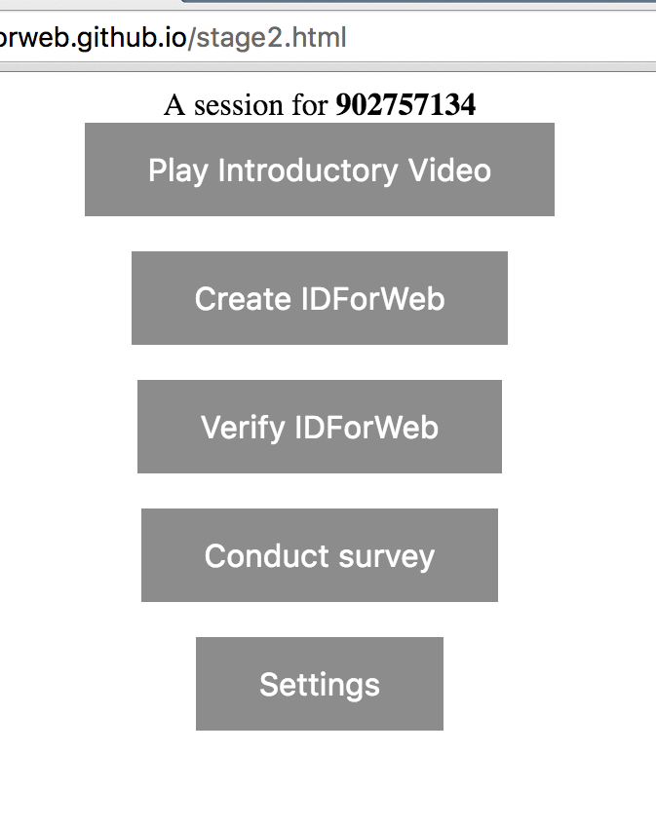
Testing Menu
5 Buttons
Introductory Video
Click to watch the introductory video again
Create IDForWeb
Click to create IDForWeb, the Task 1 for the participants
Verify IDForWeb
Click to verify IDForWeb, the Task 2 for the participants
Conduct Survey
Click to conduct survey, the final task for the participants
Settings
To update GTID if it is incorrectly typed.
Make sure your GTID is shown on top.

Slide 9
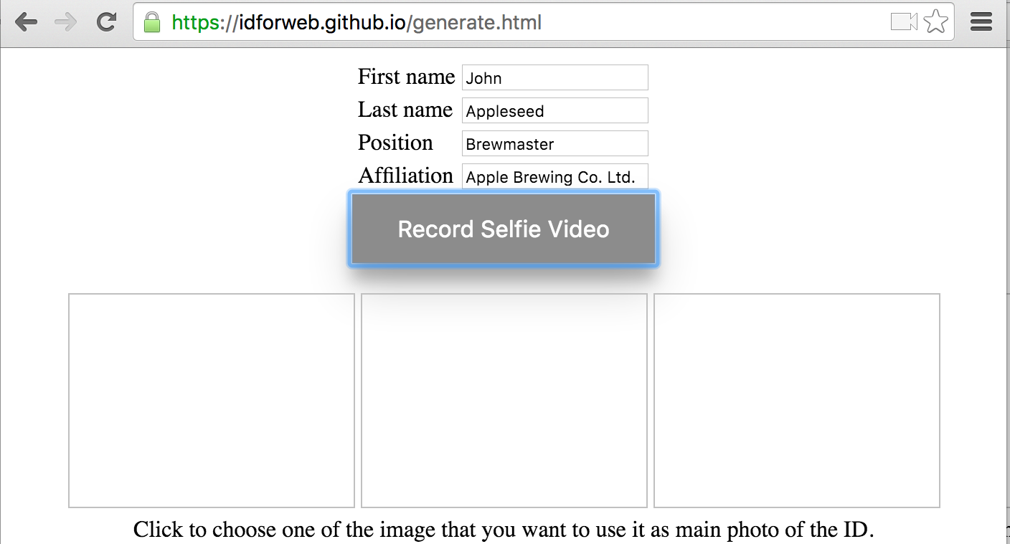
Create IDForWeb (Task 1)
To create IDForWeb,
1. Type user information on the form, such as
First name
Last name
Position (in affiliation)
Affiliation
2. Then, click Record Selfie Video
Caveat: You should allow access to microphone & camera to the browser
Click ‘Allow’ to enable recording

Slide 10
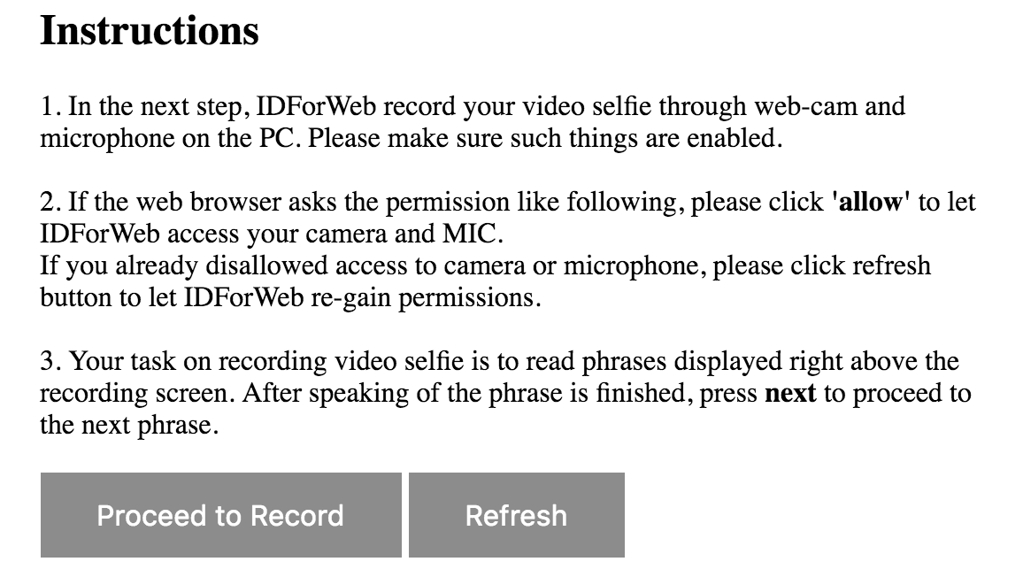
Create IDForWeb (Task 1)
Recording Selfie Video
A. Click ‘Proceed to Record’ to begin recording

Slide 11
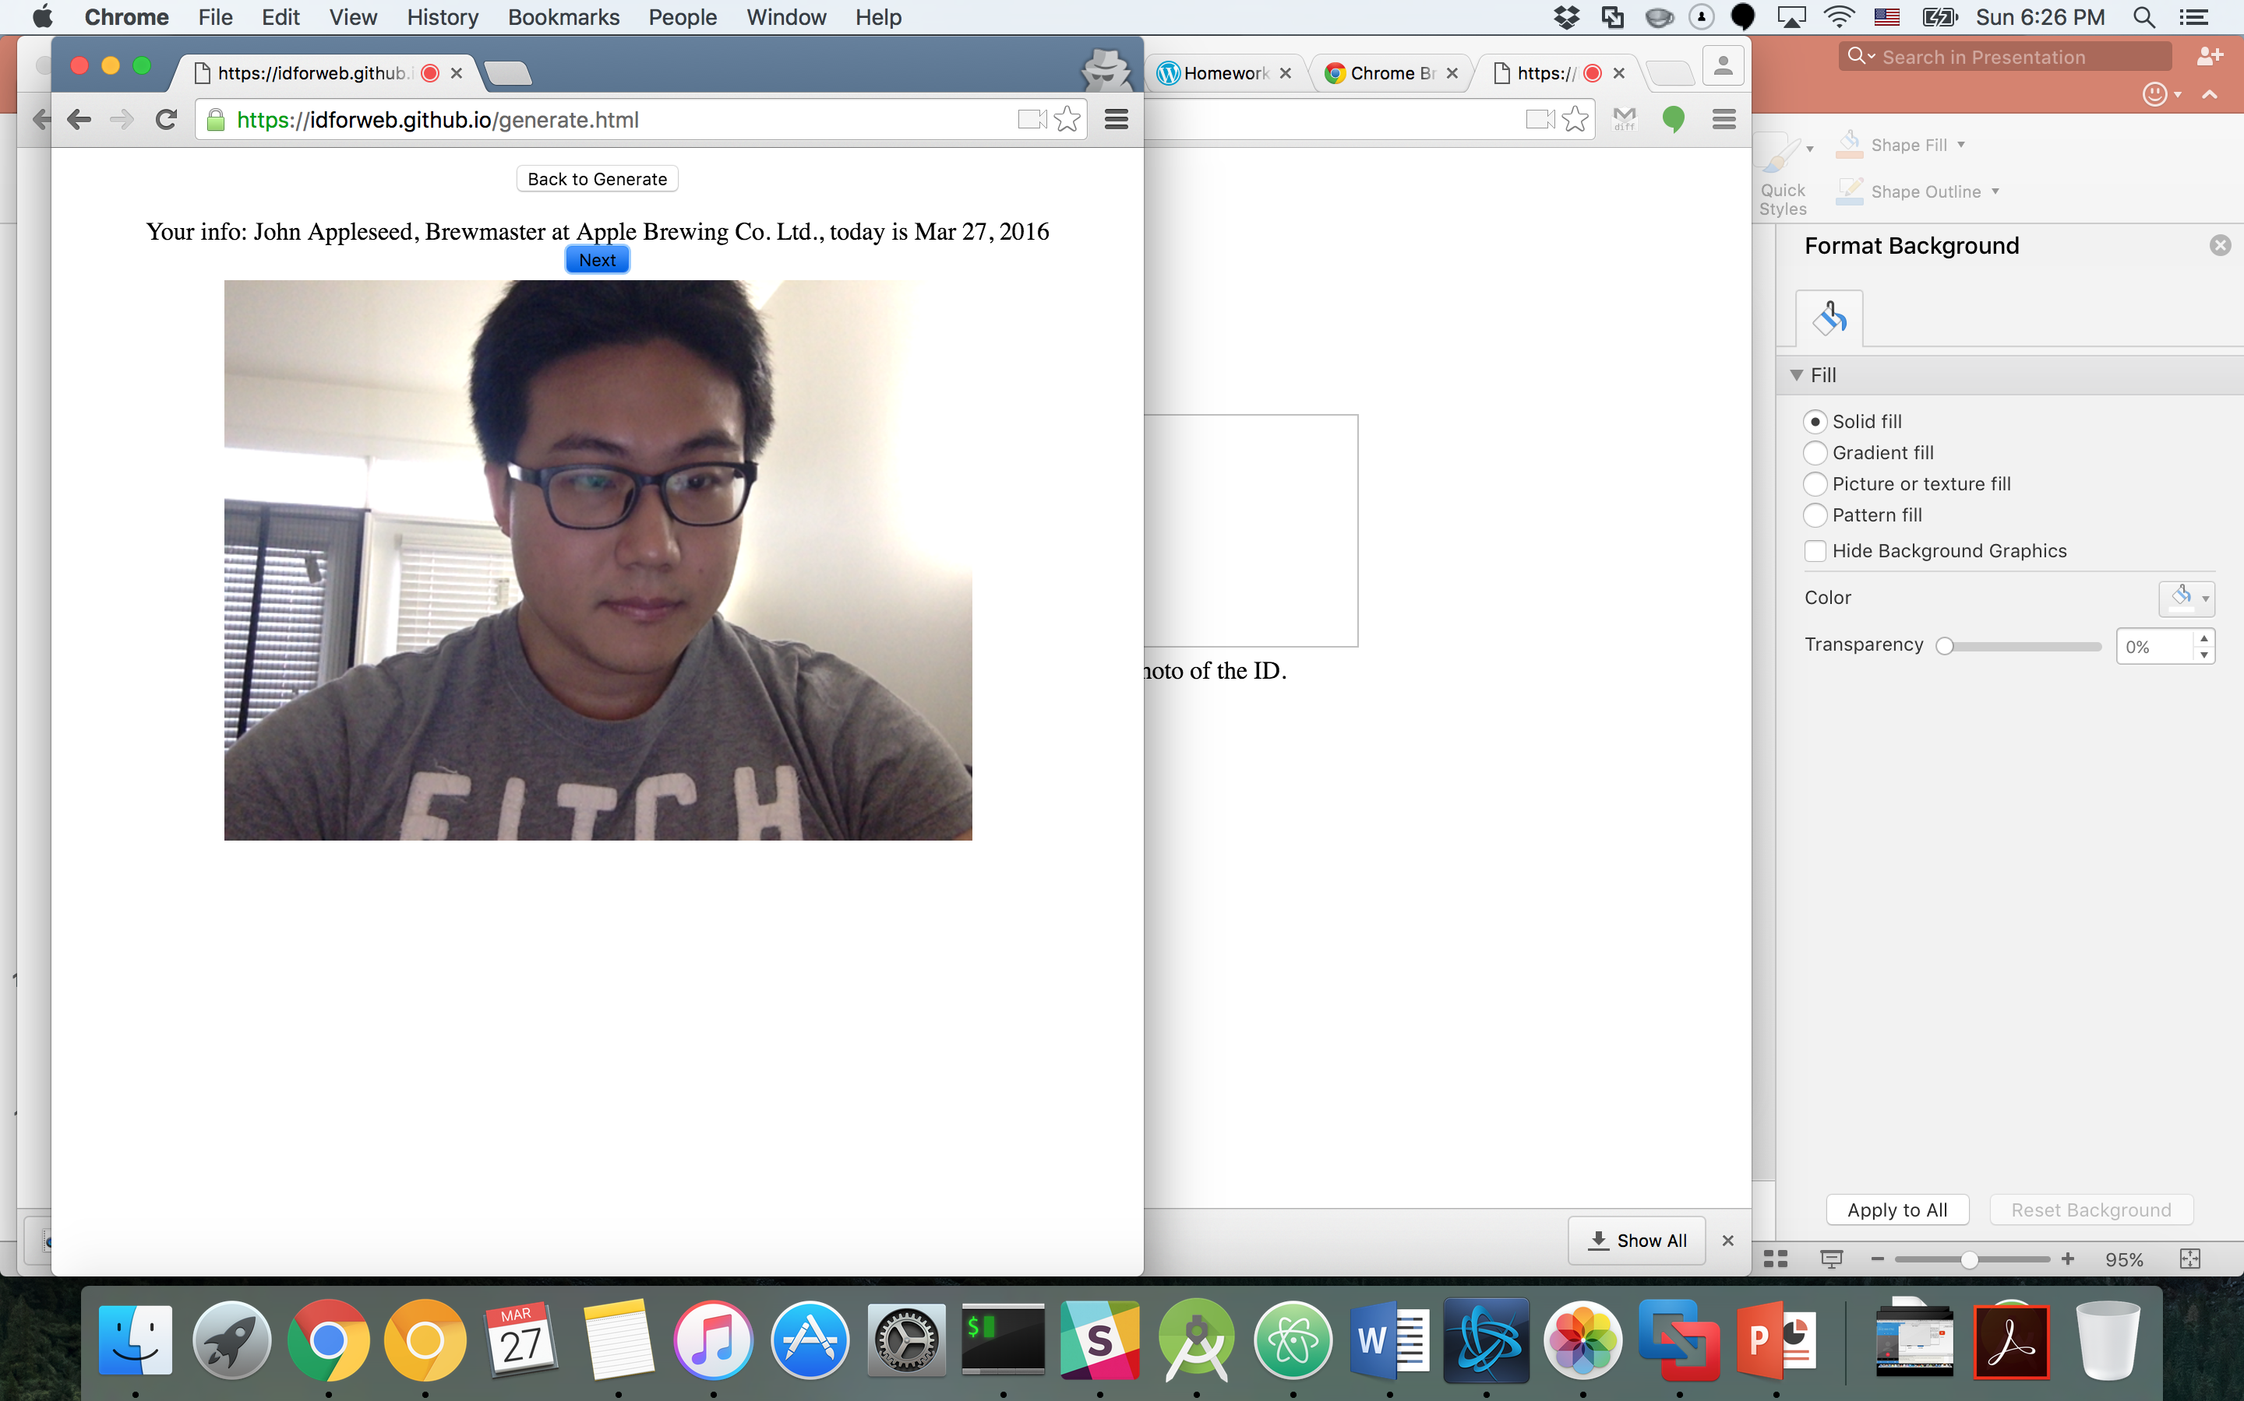
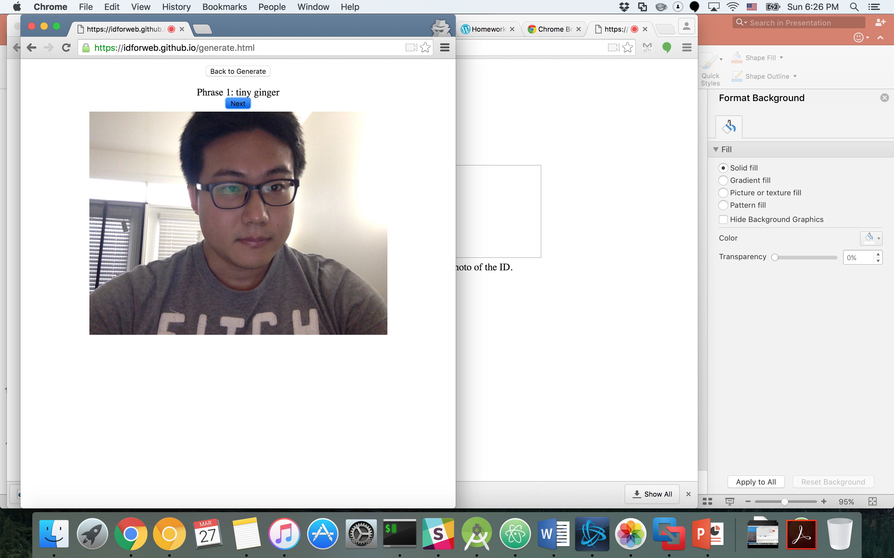

Create IDForWeb (Task 1)
Recording Selfie Video
B. When Phrase comes in, read the phrase,
C. Click ’Next’ if speaking of each phrase is finished.
D. At the end, click ‘Done’ if you finish with all phrases.

Slide 12
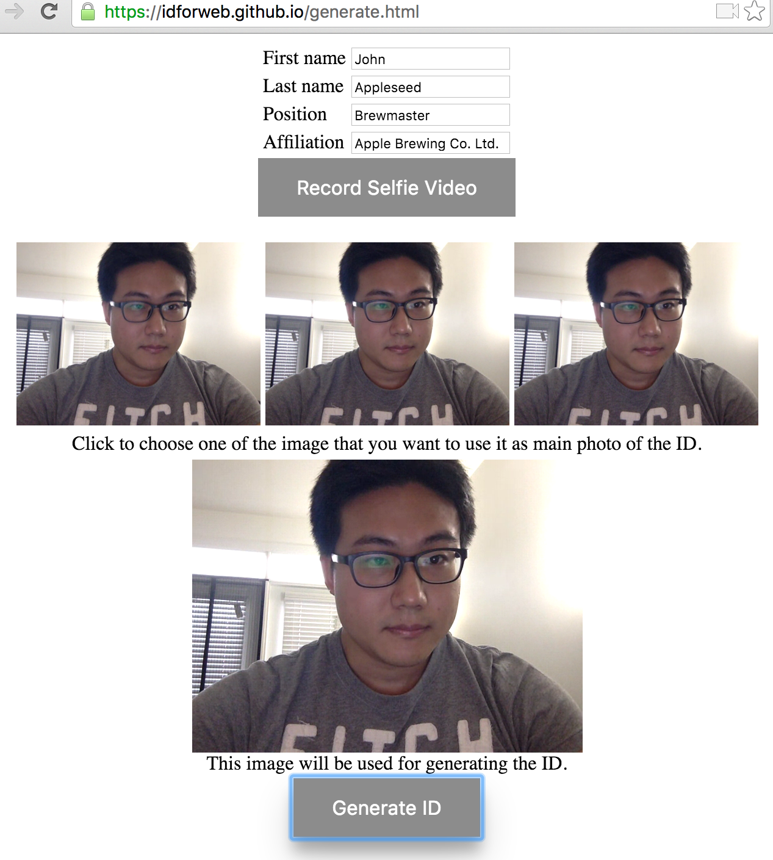
Create IDForWeb (Task 1)
Now, the snapshot of videos will be shown on the bottom.
Click on the one of the picture that will be used as a main photo for the ID.
Preview will be shown on the bottom.
Then, click ‘Generate ID’ to create IDForWeb

Slide 13
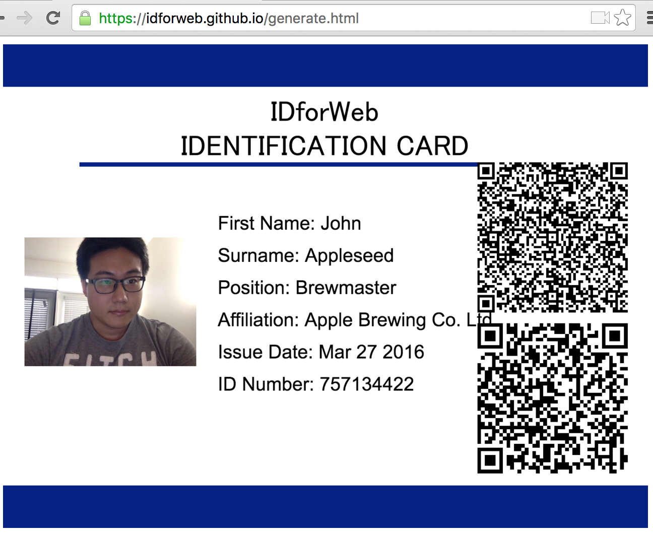
IDForWeb
The next screen will show the created IDForWeb on the screen.
Click to the ID to launch Verify session (Task 2)

Slide 14
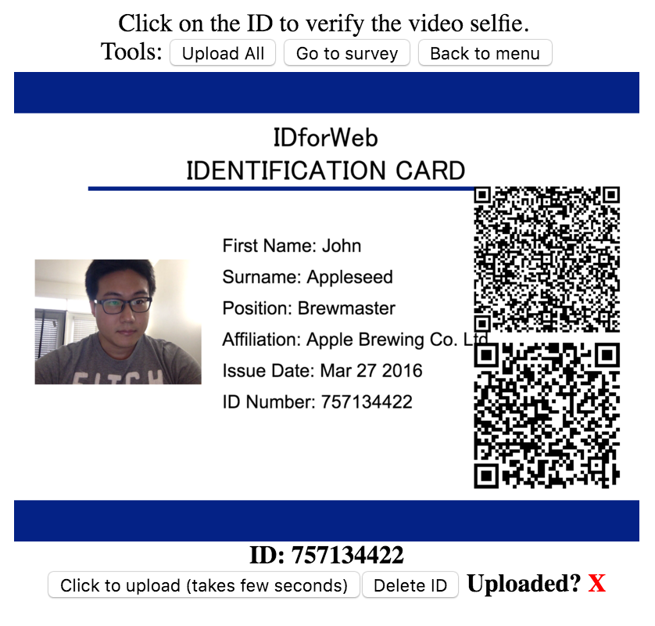
Veryfy IDForWeb (Task 2)
Click on the ID (Picture) that you want to run Verify

Slide 15
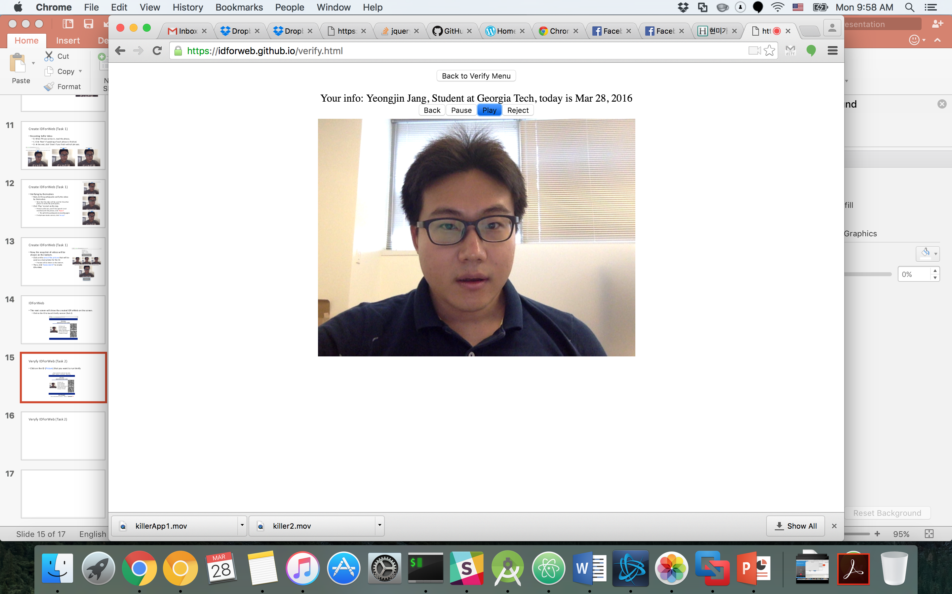
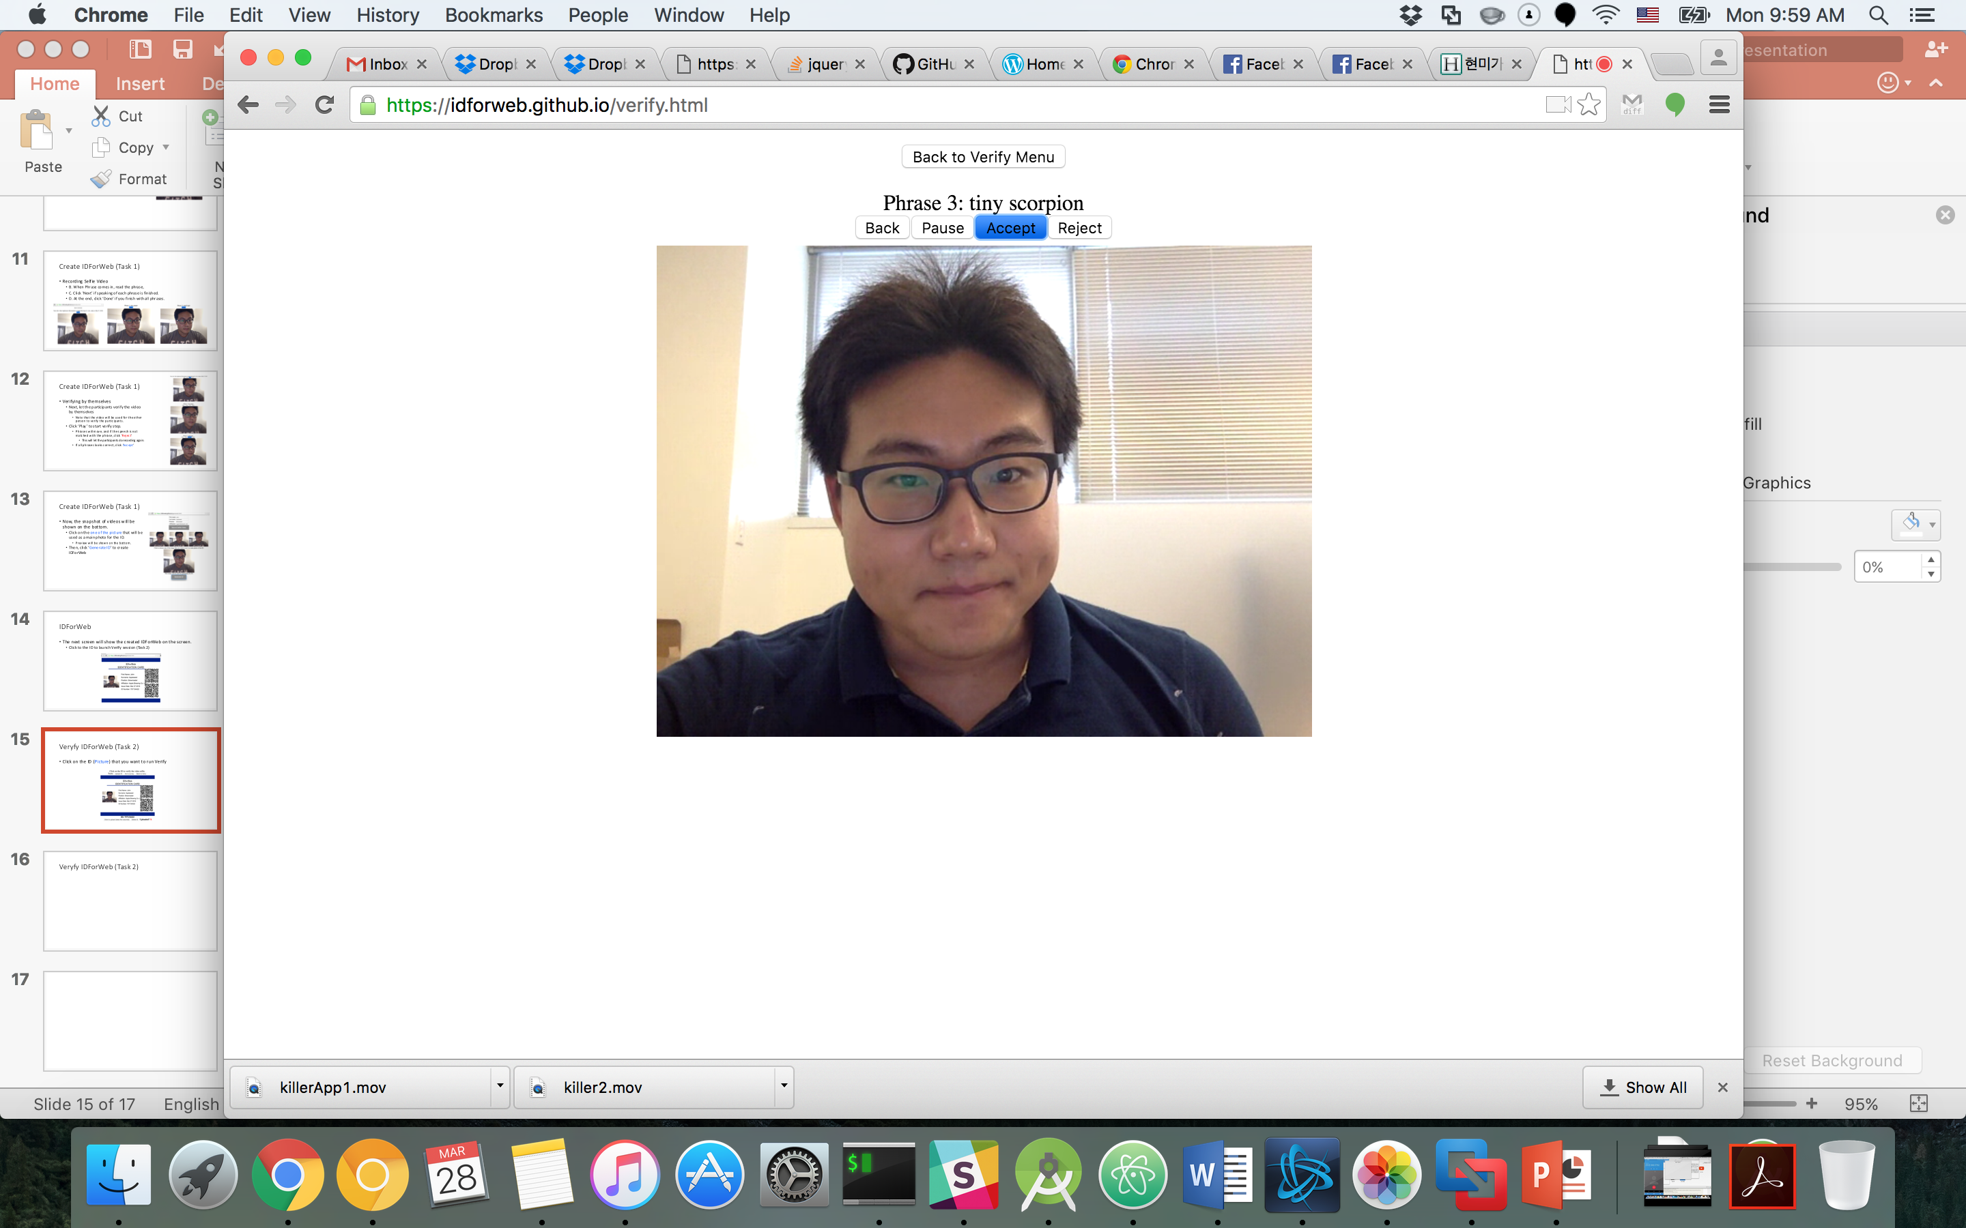

Veryfy IDForWeb (Task 2)
Click ‘Play’ to start verifying session.
Click ‘Accept’ if all phrases are spoken correctly.
Click ‘Reject’ if any of phrase was wrong.

Slide 16
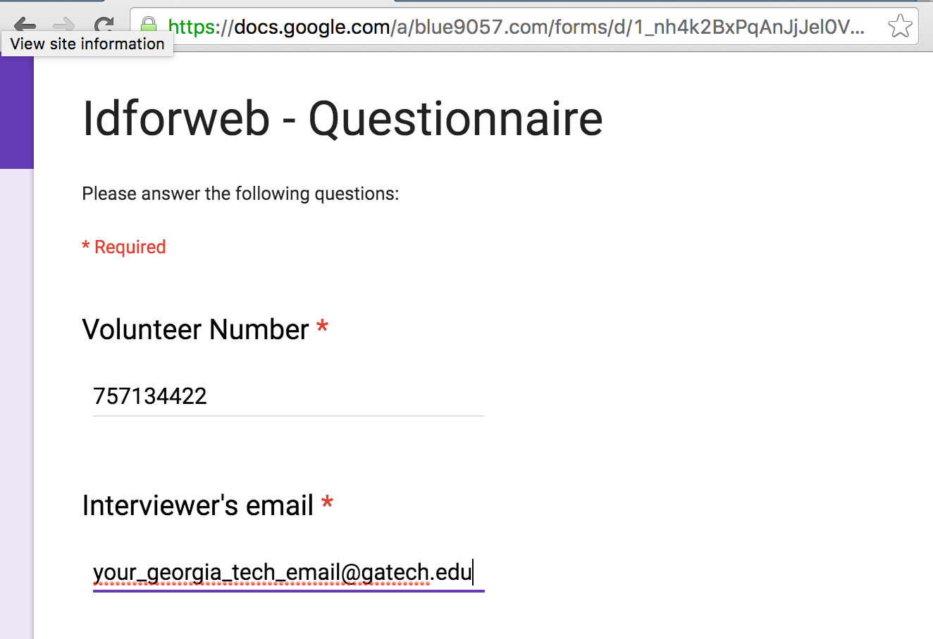
Conduct Survey
After Task 1 and 2 are finished, let participants conduct survey.
It is required to sign-in to Google because it is a Google Form, so please let participant do so.
Type volunteer Number as
Number in created ID..

Slide 17
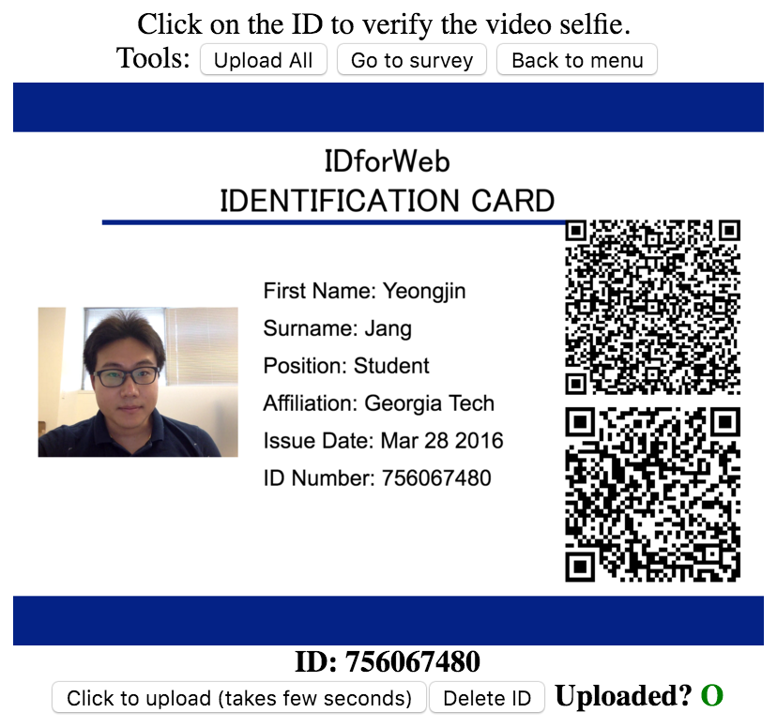
Uploading of the ID
To grade your testing assignment, we collect generated ID into our server.
Note that we encrypt, and having strong access control on the server-side
The ID will not be accessed by public.
Please click ‘Upload’ button on verify menu (or click upload-all)
Note that each video contains around 10MB, so please try upload when you are having suitable Internet connection.
After upload is finished, a green circle will be displayed.

Slide 18
Caveat
If camera does not work on Google Chrome, then install Chrome Canary (in Windows and Mac OS X) or Chromium (in Linux)
https://www.google.com/chrome/browser/canary.html
http://askubuntu.com/questions/250773/how-do-i-install-chromium-from-the-command-line
If recording does not work, then try to click refresh, or close all browser window / or close other programs that uses camera and try again.

Slide 19
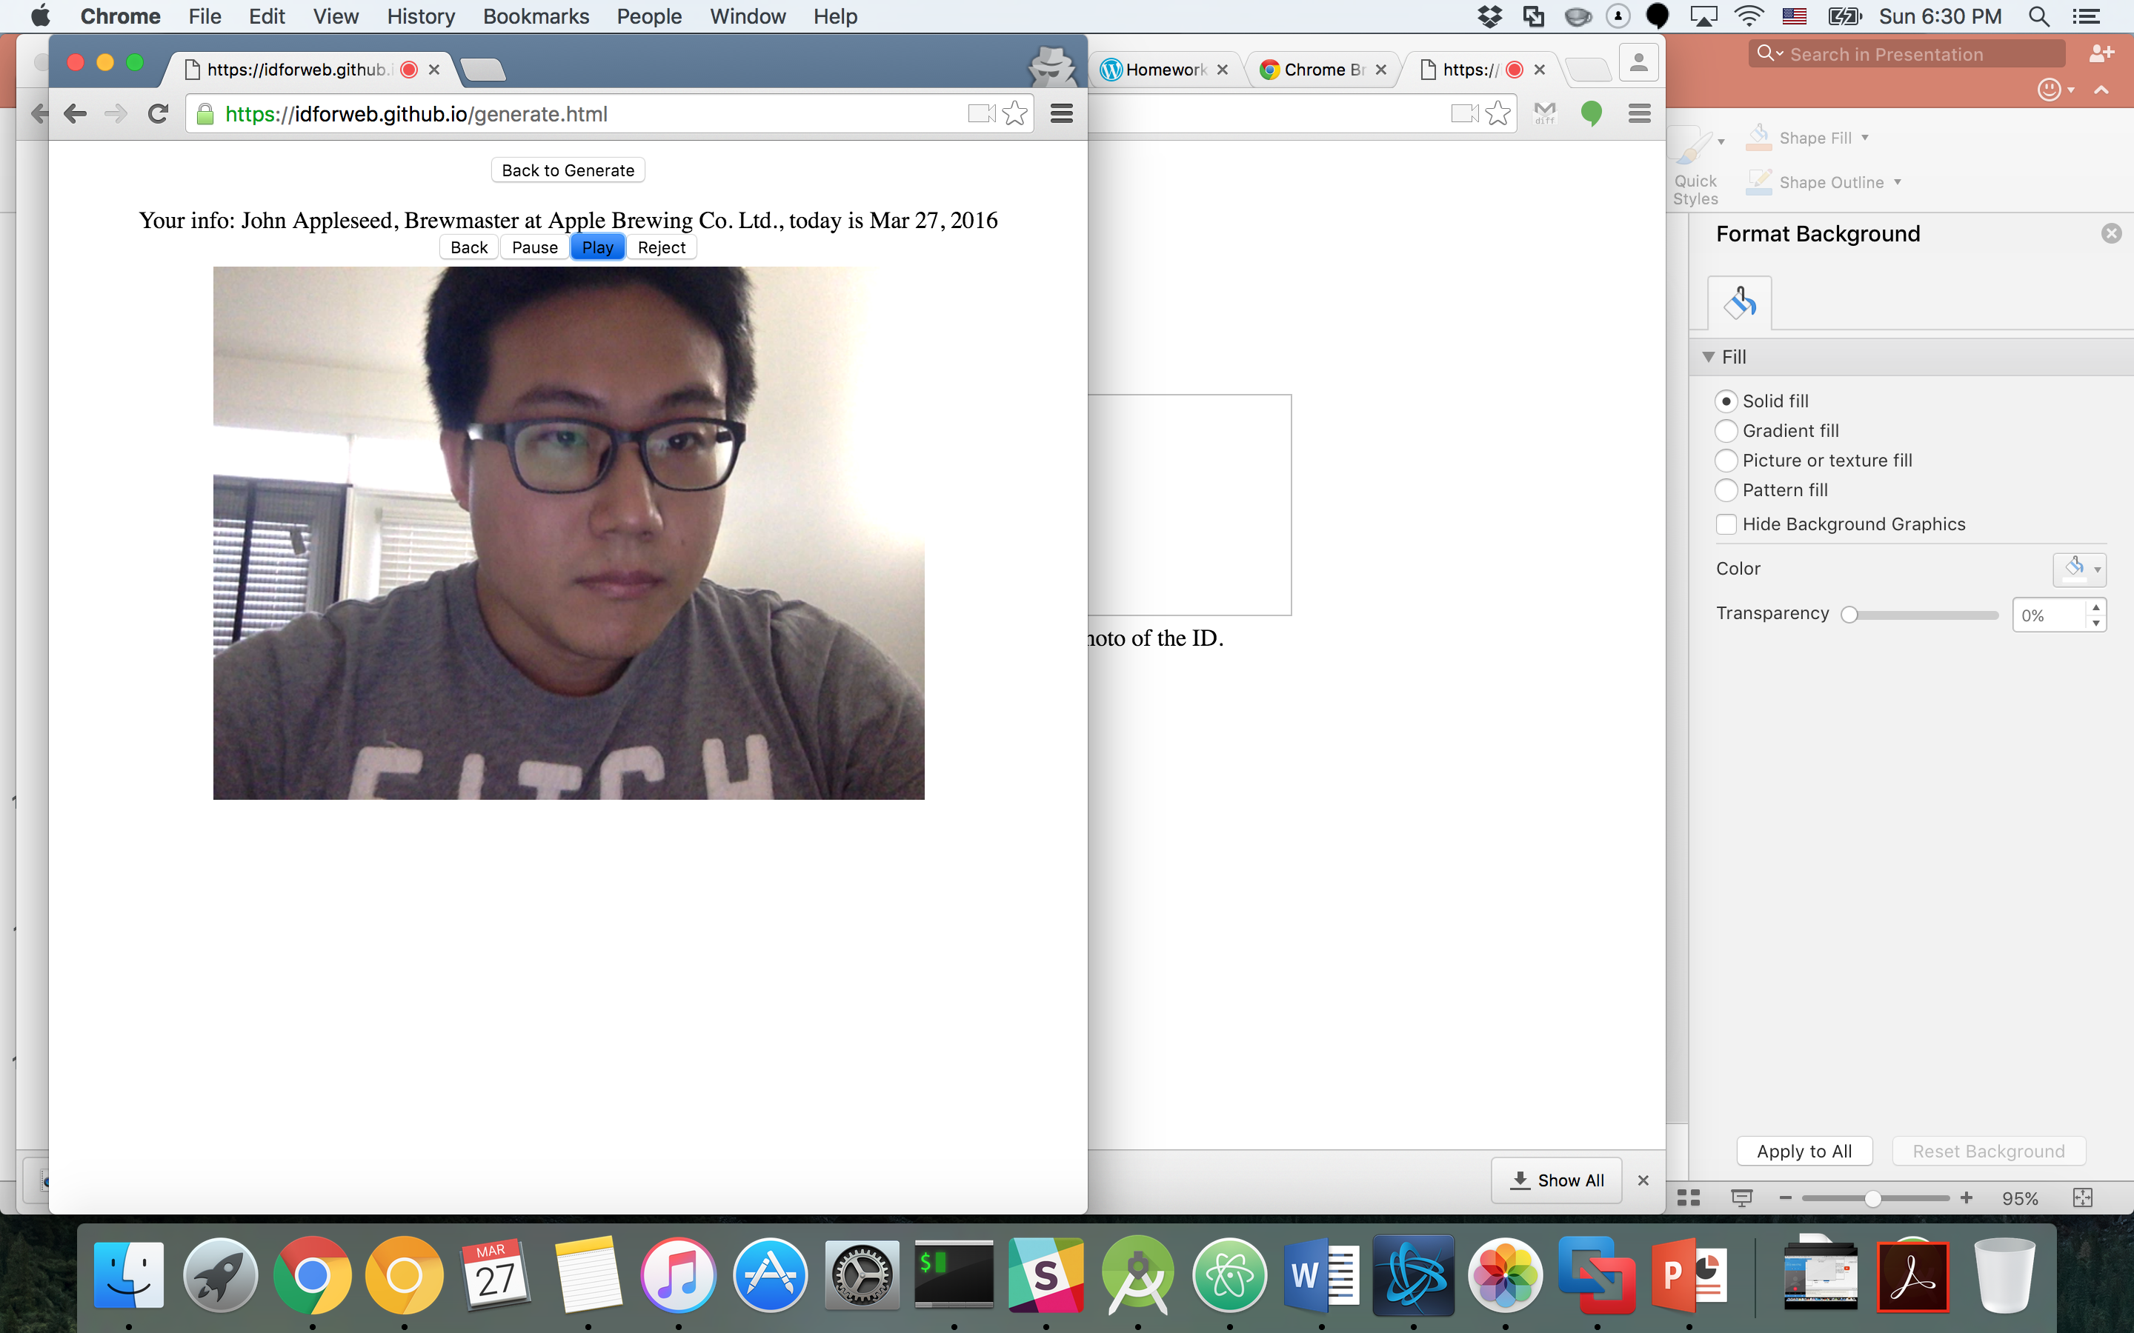
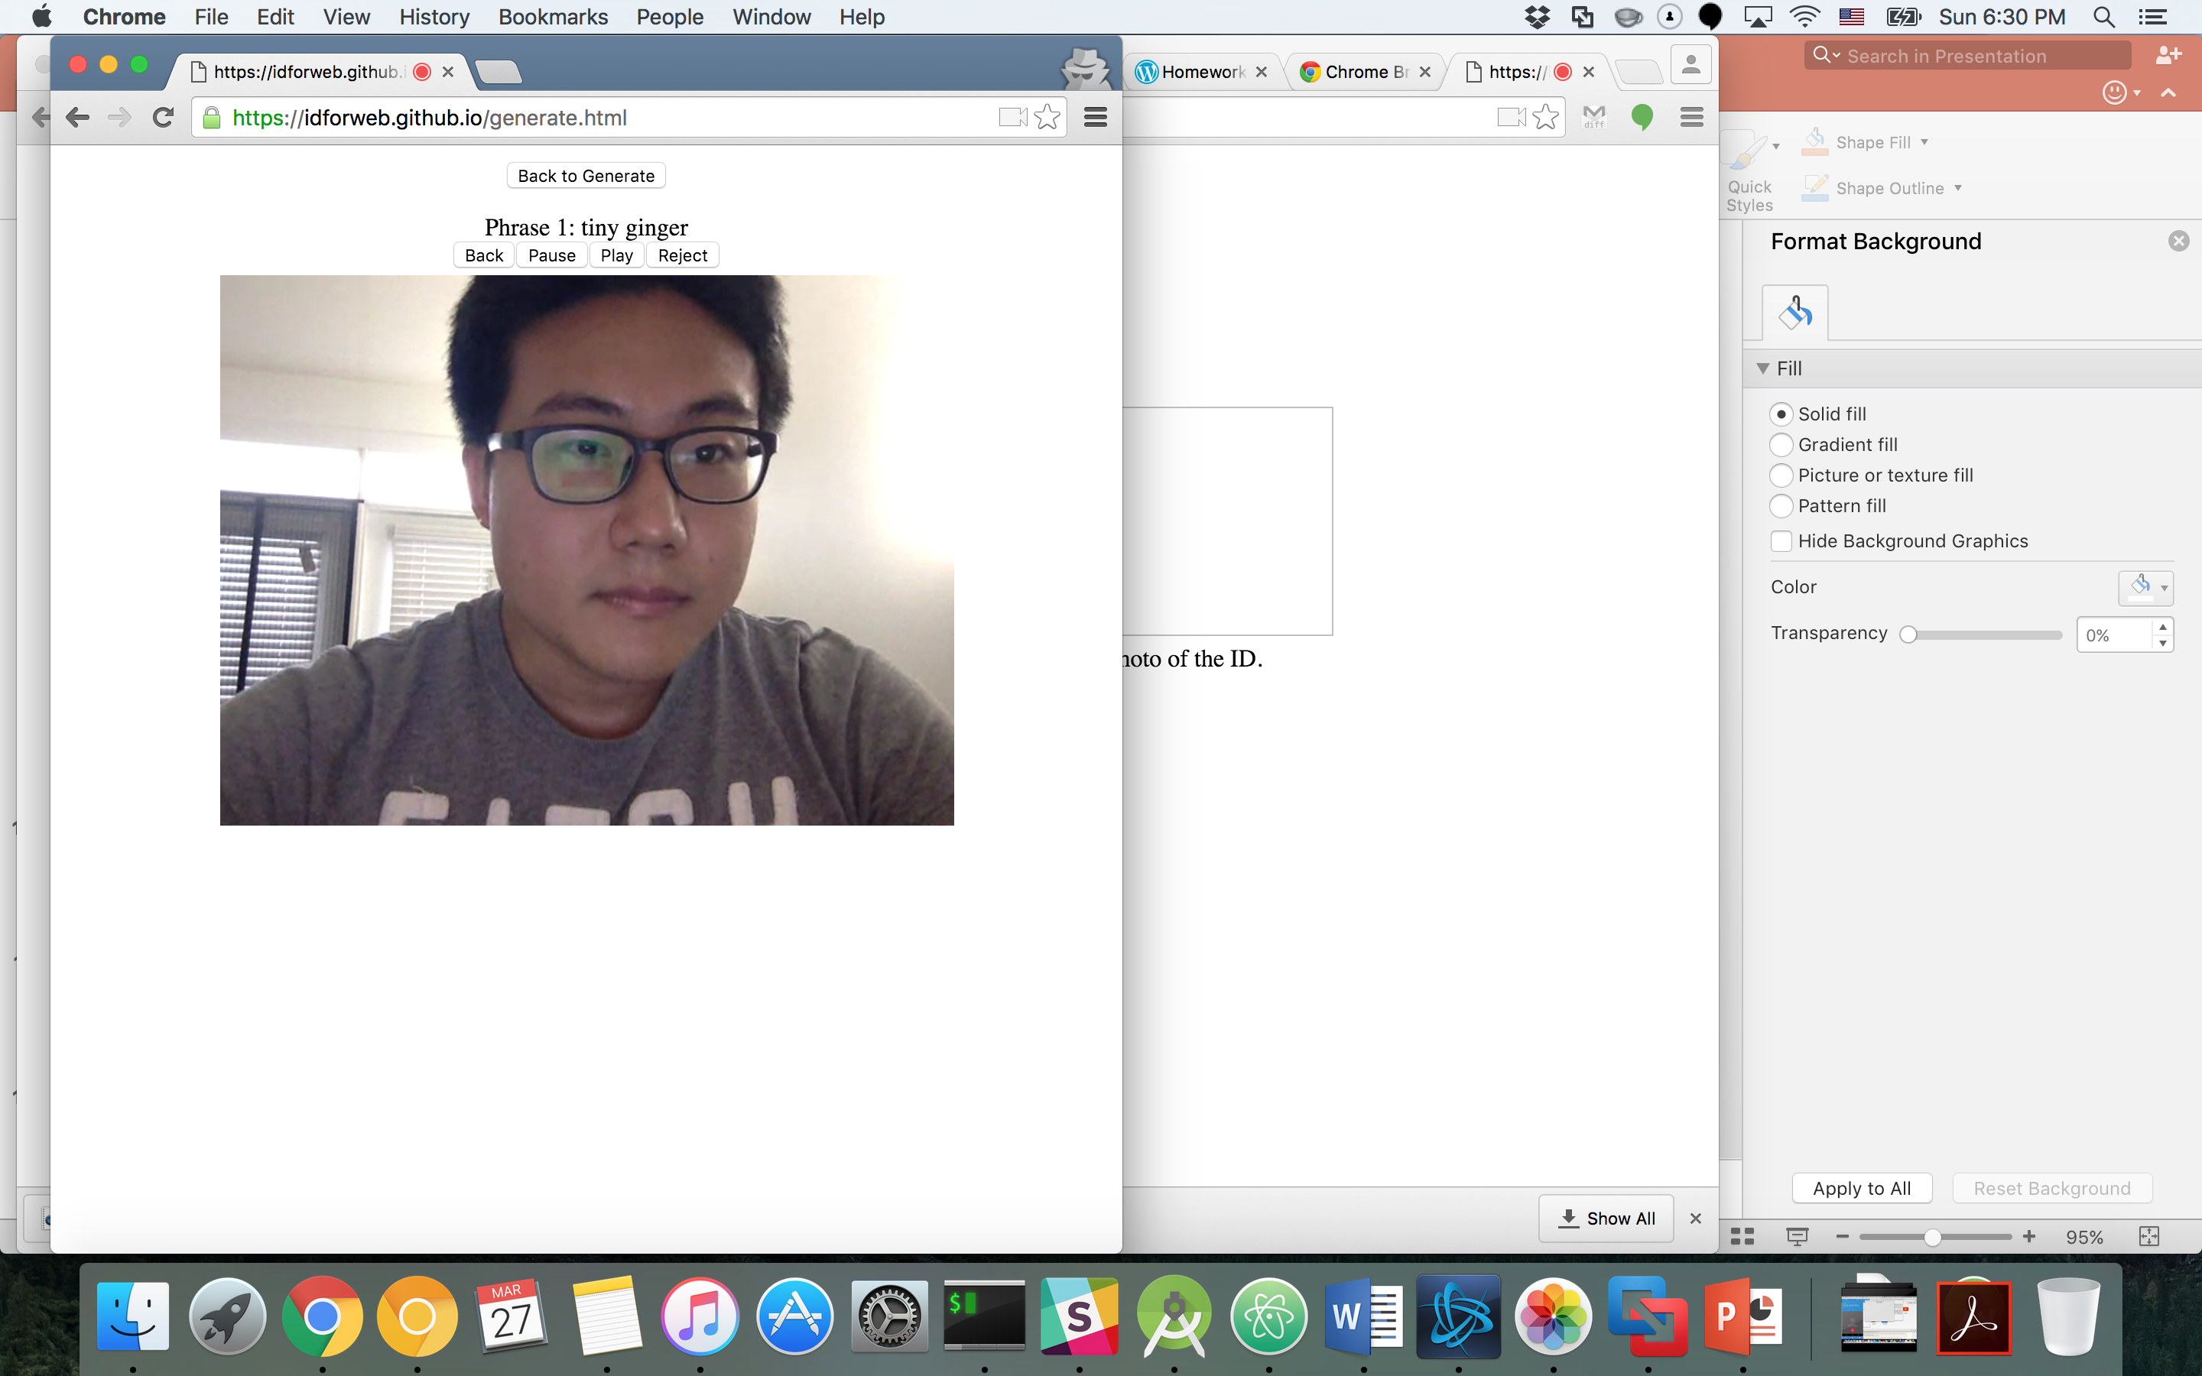

Create IDForWeb (Task 1)
Verifying by themselves
Next, let the participants verify the video by themselves
Note that the video will be used for the other person to verify the participants.
Click ‘Play’ to start verify step.
Phrases will move, and if the speech is not matched with the phrase, click ‘Reject’
This will let the participants do recording again.
If all phrases looks correct, click ‘Accept’

